Slide 1


Voice quality analysis in forensic voice comparison: developing the vocal profile analysis scheme
Eugenia San Segundo, Paul Foulkes, Peter French Philip Harrison & Vincent Hughes
University of York & J P French Associates
IAFPA 2016
University of York
24-27 July

Slide 2
1. Introduction
survey of practitioners (Gold & French 2011)
voice quality (VQ): one of most valuable features
94% examine VQ
68% of those do so ‘routinely’
61% use recognised framework (e.g. VPA)
21% perform “auditory analysis and provide some form of a verbal description”
Notes:
The international survey of Forensic Speaker Comparison (FSC) practices carried out by Gold and French (2011) revealed that
94% of the respondents –forensic practitioners– examine voice quality (VQ) as part of their comparison procedures.
68%. ... First ascer’tainment of problems involving VQ in most forensic conditions… we will see later
In terms of how they use VQ as a feature in forensic casework (auditory approach to VQ)
61% use a recognized framework
21% of experts performed “an auditory analysis of voice quality and provided some form of a verbal description” (i.e. not following pre-established protocol)

Slide 3
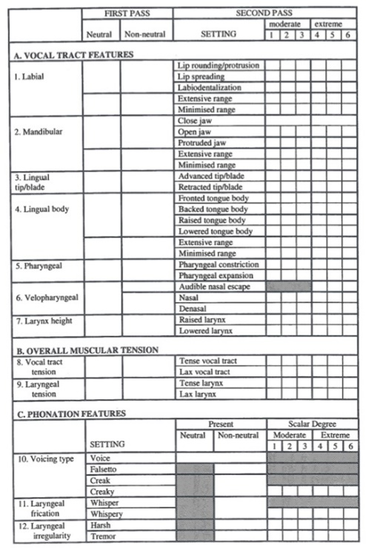
Vocal Profile Analysis
framework for systematic description of VQ
developed by Laver et al. (1981)
modified by Beck (2007)
25 supralaryngeal
7 laryngeal
comparison against ‘neutral setting’
clearly defined baseline with concrete acoustic and physiological correlates
Notes:
- VQ defined as…“non-segmental features of speech which characterize an individual’s habitual speech patterns” (Beck 2005)
- Including overall muscular tension settings
- All voices are compared against

Slide 4
1. Introduction
issues with VPA for FVC (Nolan 2005, 2007)
1) lack of training
2) practical considerations of time
3) quality of samples (telephone trans., short)
+ courts need to know reliability of the method
+ analyses should rely on non-correlated features
Notes:
- Nolan (2005, 2007) first systematic discussion about the application of VQ analysis to FVC, with an emphasis on issues with VPA
- Some of these are:
1------since the componential analysis of VQ is not considered part of traditional auditory-phonetic training, the number of phoneticians proficient in this approach is much smaller than those proficient in describing phonetic quality (Rose, 2002: 280).
2--------carrying out a complete VQ profile of two or more voice sample is a time consuming task. Samples have to be evaluated for around 40 different settings, most of which require careful and repeated listening. The magnitude of the task may contribute to the lack of use of the protocol
3--------the most fundamental ‘barrier to the application of VQ componential analysis. VQ is compromised by the distorting effect of telephone transmission, sometimes samples are too short to carry out a full VQ analysis…. Other problems like background noise…mask the true VQ.
To these frequently mentioned problems, we could add two further issues
+… (margin of error) – for VPA settings, the question of rater reliability and agreement has been seldom explored
+… (avoid doubling evidence) – this makes the investigation of correlation highly relevant.

Slide 5
1. Introduction
general issues with perceptual methods (VQ)
bias and errors (Kent, 1997)
interrater disagreements (Kreiman et al. 2011)
VPA reliability with forensic data not reported yet
multidimensionality of VQ
dimension reduction (Bele, 2007)
dimensions difficult to isolate
interrelated dimensions
risk of overestimation
Notes:
- Besides, is well known that analyses based on perceptual skills – even on those of trained phoneticians – are subject to bias and errors (Kent, 1997), which may call into question the reliability of such auditory evaluations.
- In relation to the evaluation of VQ in particular, inter-rater disagreements have plagued the history of perceptual studies (Kreiman and Gerratt, 2011).
Well reported in clinical studies but to the best of our knowledge, VPA reliability…
- Multidimensionality is considered an important challenge in the perceptual assessment of complex stimuli, and human voices are such complex sounds. Some studies have focused on how perceptual dimensions overlap and group (e.g. Bele, 2007)…. again in clinical studies….and factor analyses have often been used for dimension reduction.
- Furthermore, listeners cannot always isolate for judgement one perceptual dimension from several co-occurring dimensions (Kent, 1996). Therefore, if perceptual ratings of various dimensions are interrelated –not entirely independent – there is a risk of overestimation.

Slide 6
2. Research questions
what changes can we make to improve VPA usability for FVC? → simplified VPA
how often do VPA settings occur? frequency
how reliable are VPA ratings across different analysts? interrater agreement
to what extent are VPA settings independent? correlation tests
Notes:
(The present study addresses these questions and proposes developments for the VPA in FVC.)

Slide 7
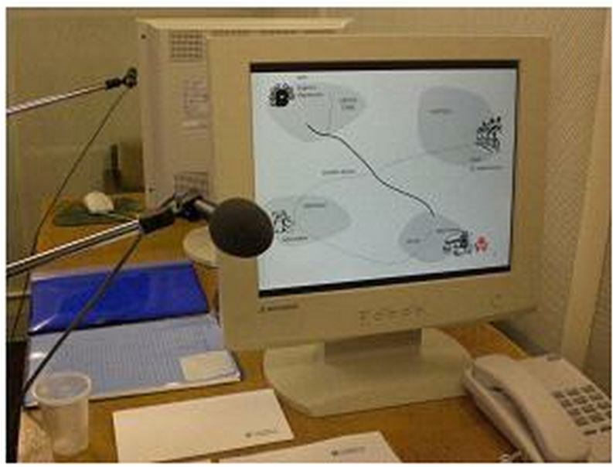

3. Data
DyViS Corpus (Nolan et al. 2009)
100 male speakers
Standard Southern British English (SSBE)
18-25 years old
Task 2
information exchange over telephone
HQ, near-end recording
(c. 10-15 mins)
Manual editing:
Removed…
Overlapping speech
Background noise
Extended pauses
Notes:
manual editing: removed overlapping speech, background noise, extended pauses -→ real duration of each voice samples we examined was actually smaller (around 5 min).

Slide 8
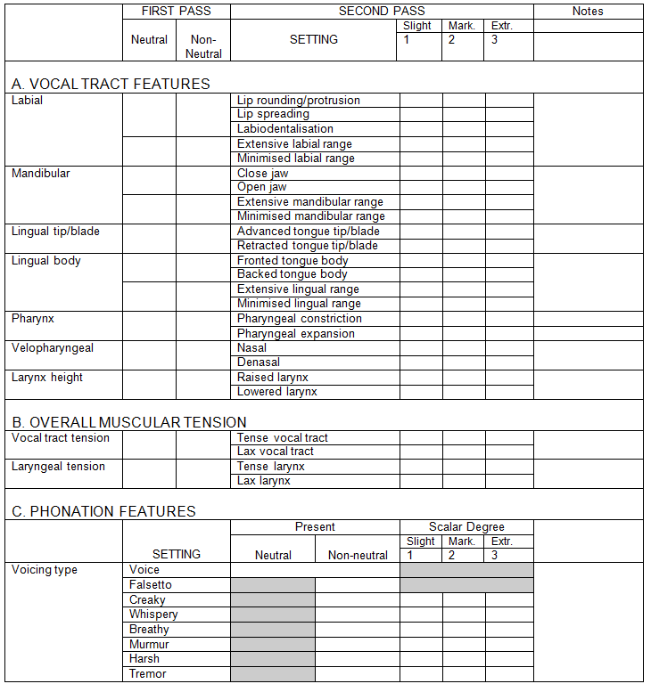
4. Methods
VPA simplified version
reduced scalar degrees
‘present’ features (1-3)
reduced N settings
combined:
fronted + raised
backed + lowered
creak + creaky
whisper + whispery
Notes:
- We used the simplified VPA protocol used in JPFrench Associates, which is in turn based on Beck’s template.
- Its main characteristics are:
Reduction of scalar degrees from 6 to 3
Reduction of number of settings
Collapsing settings that present similar descriptions of articulatory strategies (backed and lowered). Or where differences are really subtle (creak and creaky) – creakiness / whisperiness
Or just removing those that are supposed to be more pathological (audible nasal escape) or rare

Slide 9




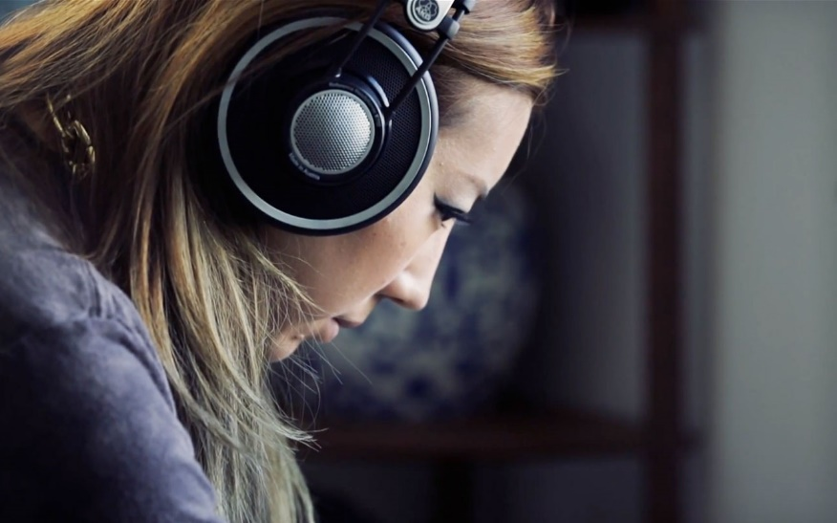
4. Methods
Perceptual evaluation: - Three analysts:
- Two stages:
Blind perceptual assessment of voices
Calibration procedure
joint listening
disagreement typology:
setting reassignment
e.g. lowered larynx ~
expanded pharynx
proper disagreement
e.g. missed presence of a setting
e.g. different scalar degree
Notes:
As to methods..
- we were three analysts and carried out the perceptual assessment of voices in two stages.
1. … i.e. carried out independently by each of us
2. …. (held some calibration meetings) consisted in a joint listening where we went trough all the voices checking our individual ratings and found out that there were two main types of disagreements
- data entry (from paper to Excel version)
- …
- ….

Slide 10

5. Results: setting frequency (1)
- based on the mode per setting → agreed version
Absent settings
Labiodentalization
Extensive labial range
Minimised labial range
Open jaw
Protruded jaw
Extensive mandibular range
Backed tongue body
Audible nasal escape
Falsetto
Tremor
NEUTRAL
Notes:
- As a result of our calibration meetings, we produced an agreed VPA evaluation per speaker, based on the mode.
- Results for setting frequency of occurrence are based on this agreed version.
Out of the 32 VPA settings, we can make a three-fold division:
1) the settings that never occur in the Dyvis population - absent settings

Slide 11
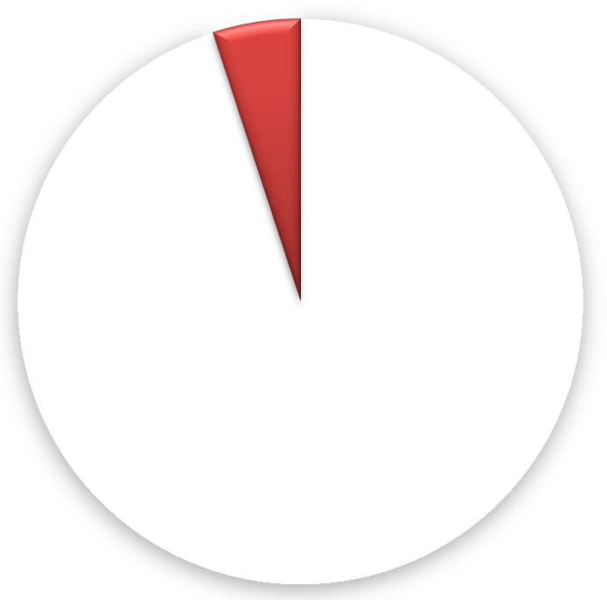

5. Results: setting frequency (2)
Rare settings (<10%)
Lip spreading (5)
Lip rounding (1)
Close jaw (1)
Min. mandibular range (4+1)
Retracted tongue tip (1+1)
Extensive lingual range (3)
Min. lingual range (0+1)
Pharyngeal constriction (3)
Pharyngeal expansion (3)
Denasal (1+3)
1-5%
NON NEUTRAL
*(N cases in brackets: slight + moderate)
Notes:
2nd group: rare settings.. We only find them in a maximum of 5 speakers – some only in one
I show the cases in brackets
- slight or moderate presence, never extreme
- PLAY SOUNDS? Denasal grado 2: 22, 63, 69

Slide 12
5. Results: setting frequency (3)
ACCENT FEATURES?
Notes:
And here we find the third group of settings, according to their frequency of occurrence.
They appear in a variable frequency.
Ordered from the less to more frequent.
Actually whispery is within this third group very unfrequent (but at least 10 cases justify their belonging in this group and not in the last one).
---
The last 4 are especially frequent in Dyvis mostly present in degree “1”, although other marked and even extreme cases are observed. We suggest that these are probably accent features, for this population.

Slide 13
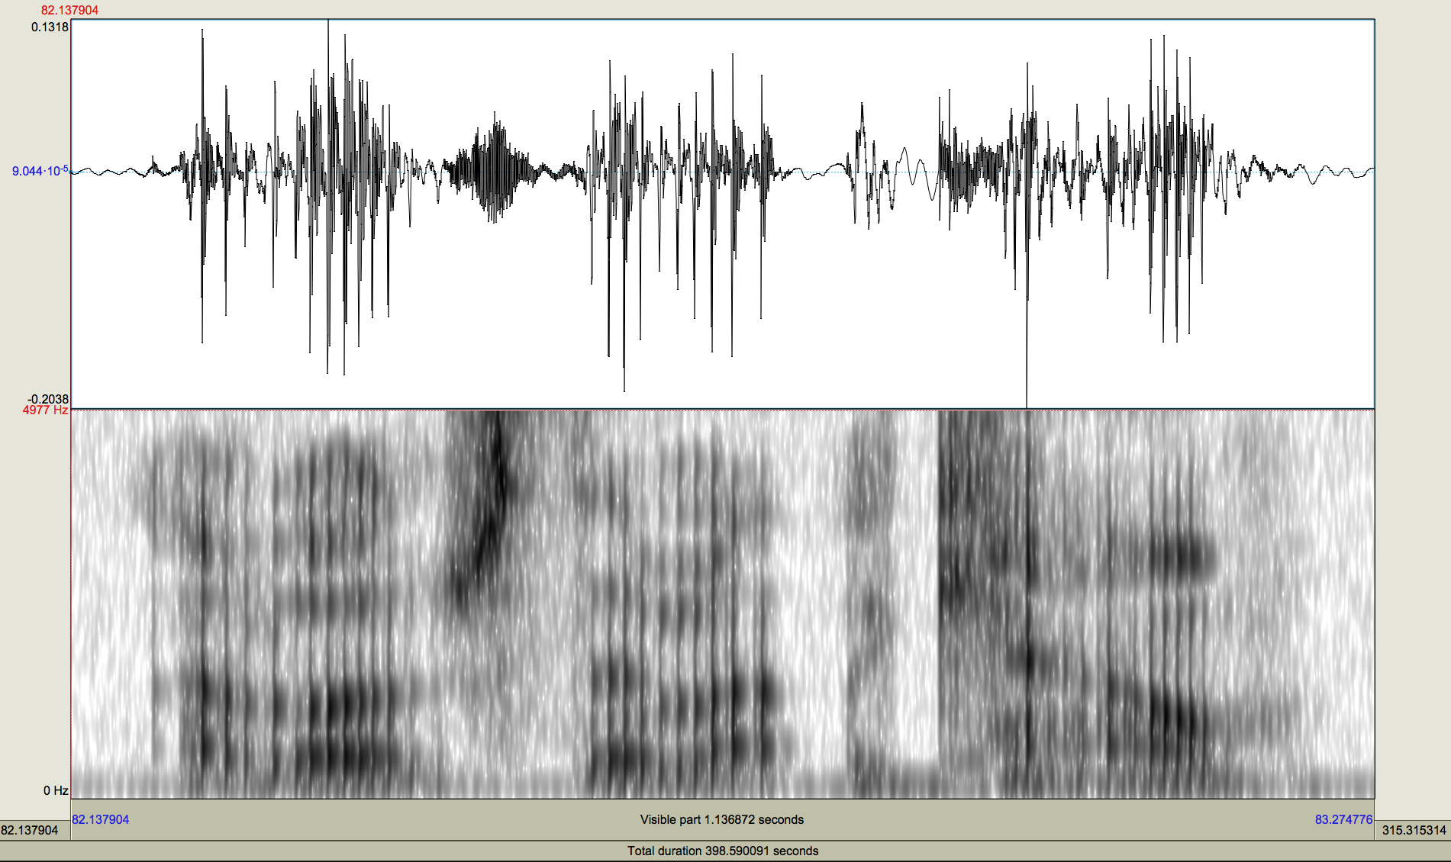
5. Results: setting frequency (3)
example creakiness – degree “3”
Notes:
Alhough we haven’t undertaken detailed acoustic analyses yet, as a way of illustration we show here an example of a speaker with creaky voice degree 3! The three raters agreed on that value.
The spectrogram is only for the end of the voice sample

Slide 14
5. Results: correlation tests (1)
based on the mode per setting → agreed version
POSITIVE CORRELATIONS | Contingency Coefficient
RAISED LARYNX - TENSE LARYNX | 0.58
NASAL - TENSE LARYNX | 0.58
HARSH - TENSE LARYNX | 0.57
LAX LARYNX - LOWERED LARYNX | 0.52
CREAKY - LAX LARYNX | 0.45
ADVANCED TONGUE TIP - FRONTED TONGUE BODY | 0.41
CREAKY - LOWERED LARYNX | 0.35
Notes:
The second question we wanted to answer was how correlated settings are.
- I only show here the highest correlation values – btw moderate and strong (0.3-0.5)
- Interestingly higher correlations refer to the tense larynx..
- We will discuss later the meaning of not obtaining higher correlation values.
---------
Nominal measures of correlation are: phi, cramer’s v and contingency coefficients. We use contingency coefficients when there are 3 or more values for each nominal variable, as long as there is an equal number of possible values

Slide 15
5. Results: correlation tests (2)
NEGATIVE CORRELATIONS | Contingency Coefficient
LAX VOCAL TRACT - TENSE VOCAL TRACT | 0.61
LAX LARYNX - TENSE LARYNX | 0.57
LOWERED LARYNX - RAISED LARYNX | 0.51
LAX LARYNX - RAISED LARYNX | 0.47
CREAKY - RAISED LARYNX | 0.44
LOWERED LARYNX - TENSE LARYNX | 0.46
Notes:
Negative correlations appear for settings that tend to be mutually exclusive.

Slide 16
5. Results: interrater measures
based on absolute scores:
 | HARSH | RAISED LARYNX | LOWERED LARYNX | TENSE LARYNX | LAX LARYNX | ADVANCED TONGUE TIP | LAX VT | TENSE VT | CREAKY | BREATHY | NASAL | FRONTED TONGUE BODY
Average pairwise agreement | 75% | 74% | 67% | 67% | 62% | 59% | 59% | 55% | 52% | 52% | 43% | 36%
Agreement raters 1 & 3 | 74% | 73% | 70% | 66% | 69% | 56% | 55% | 55% | 41% | 42% | 36% | 43%
Agreement raters 1 & 2 | 75% | 78% | 62% | 69% | 66% | 55% | 66% | 53% | 49% | 49% | 43% | 33%
Agreement raters 2 & 3 | 76% | 71% | 71% | 68% | 51% | 66% | 58% | 59% | 65% | 64% | 49% | 31%
Fleiss' kappa | 0.43 | 0.46 | 0.41 | 0.34 | 0.31 | 0.35 | 0.29 | 0.22 | 0.31 | 0.31 | 0.13 | 0.01
CREAKY | BREATHY | NASAL | FRONTED TONGUE BODY
71% | 66% | 58% | 40%
more realistic definition of disagreement:
- disagreement about presence/ absence (0-1)
- disagreement beyond 1 scalar degree (1-3)
Notes:
As for interrater results, we tested several measures, mainly % agreement and Fleiss kappa, to account for chance (i.e. kappa is a chance-corrected measure).
1st - Based on absolute scores- we find a variable percentage agreeement, i.e. agreement depends on the setting. I only show the third group of settings: those that appears in more than 10% of the population.
If we look jointly at the % agreement and Fleiss kappa most settings get good moderate agreement, especially good for the most perceptually salient (harsh, raised larynx, lowered larynx). Then we find 4 settings – which were, if you remember what we called the accent features. It seems logical that agreement gets worse here. The more frequent the setting in the population, the more difficult to find exact agreement on the scalar degree assigned to the speaker.
- We found that for those cases a more realistic definition of disagreement would be more appropriate.
If we consider disagreement as D. about presence/absence of the feature and disagreement beyond one scalar degree, i.e that a rater assigns a 1 and at least another rater assigns a 3, % agreemenT improves considerable using this redefinition.

Slide 17
6. Discussion: setting frequency
useful for typicality and LR calculation
e.g. absent settings (in this population)
phonatory settings: falsetto, tremor
supralaryngeal settings: open jaw, protruded jaw, audible nasal escape
→ mostly linked to pathological conditions (Beck, 2007)
e.g. rare settings
supralaryngeal settings: lip spreading, lip rounding, denasal
→ need to consider non-contemporaneous recordings:
within- speaker differences?
Notes:
To sum up our results…
- We consider that the analyis of the setting frequency of occurrence can be useful for future LR calculation, for the typicality term of this formula.
- especially the frequency results for absent settings and rare settings.
In our case, for the Dyvis population – task 2 at least, we know that absent phonatory settings are…VT settings are… (mostlly linked to…) while rare setting would be…
But of course we need to consider non-contemporaenous recordings… to find out if there are within-sp differences, as I said, by looking at other tasks of DyVIS corpus.

Slide 18
6. Discussion: correlation
results according to phonetic theory
harsh ~ tense larynx
creaky ~ lax larynx ~ lowered larynx
other deserve further exploration
nasal ~ tense larynx
…but correlations < .60 suggest that further VPA simplifications → not necessary!
Notes:
The results for correlation seem to be in good accordance with phonetic theory. For example, harsh voice is associated with tense larynx while creaky is associated with lax larynx and lowered laynx.
Other correlations deserve further exploration
But the most interesting thins is probably that correlations are never too high as to suggest that further settings should be collapsed, merged into one. That is, it’s probably worthy to keep harsh setting and tense larynx bcs not all the speakers rated as tense larynx are necessarily harsh speakers.

Slide 19
6. Discussion: interrater
overall % agreement = good
some settings easier to agree upon? more salient?
harshness also high % agreement in previous studies (Beck 2005: 84%)
lower % agreement may have simple solutions:
increase training
search for acoustic correlates
e.g. different types of creaky? (Keating et al. 2015)
e.g. prosodic correlates of vocal tract tension?
Notes:
… or search for acoustic correlates which can help us converge in our ratings, by having not only some visual aid but proper acoustic measures.

Slide 20
5. Conclusion & Future work
first attempt at simplifying VPA for FVC
overall good interrater agreement
systematic patterns (individuals/listening strategies)
promising speaker discriminatory value
to what extent is a speaker’s profile variable across recordings? / how useful is VPA for speaker discrimination?
complement to ASR? (e.g. detection of differences between speakers in falsely accepted trials; González-Rodríguez et al. 2014. )
Notes:
- In conclusion, this is our first attempt at…
-There seems to be overall good interrater agreement.
- What remains to be investigated iis the speaker discriminatory value of VPA score.

Slide 21


Thanks! Questions?

